Slide 1
August 2016
Boomi Development Process - Advanced

Slide 2
Agenda
Monitoring & Health check
Manual procedure
Automatic procedure
Exceptions handling
Event based (NRT) processing
Introduction to Boomi listeners
SuccessFactors event based approach

Slide 3
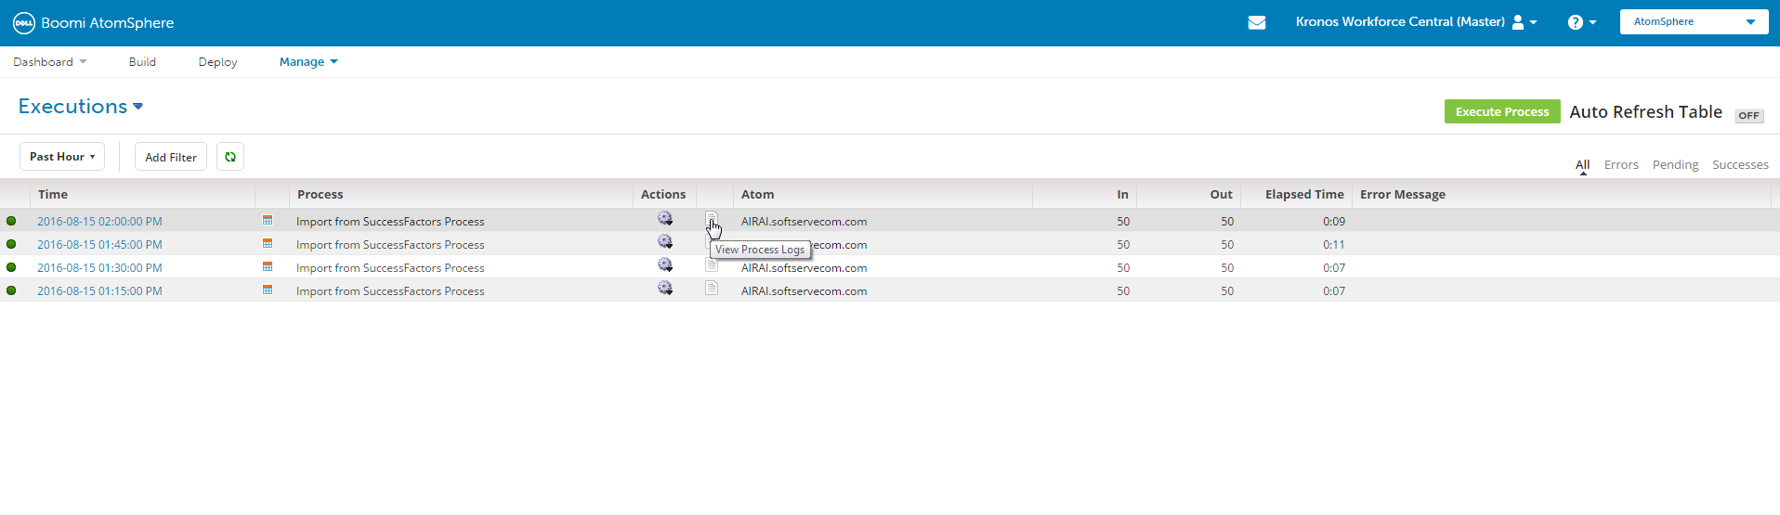
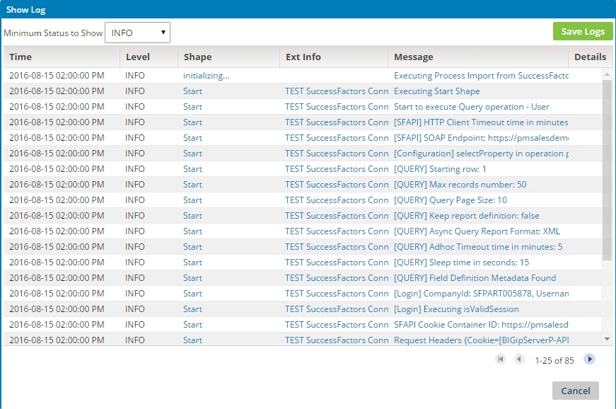
Manual process monitoring
1. Checking process status in Dell Boomi “Manage” -> “Process Reporting”

Slide 4
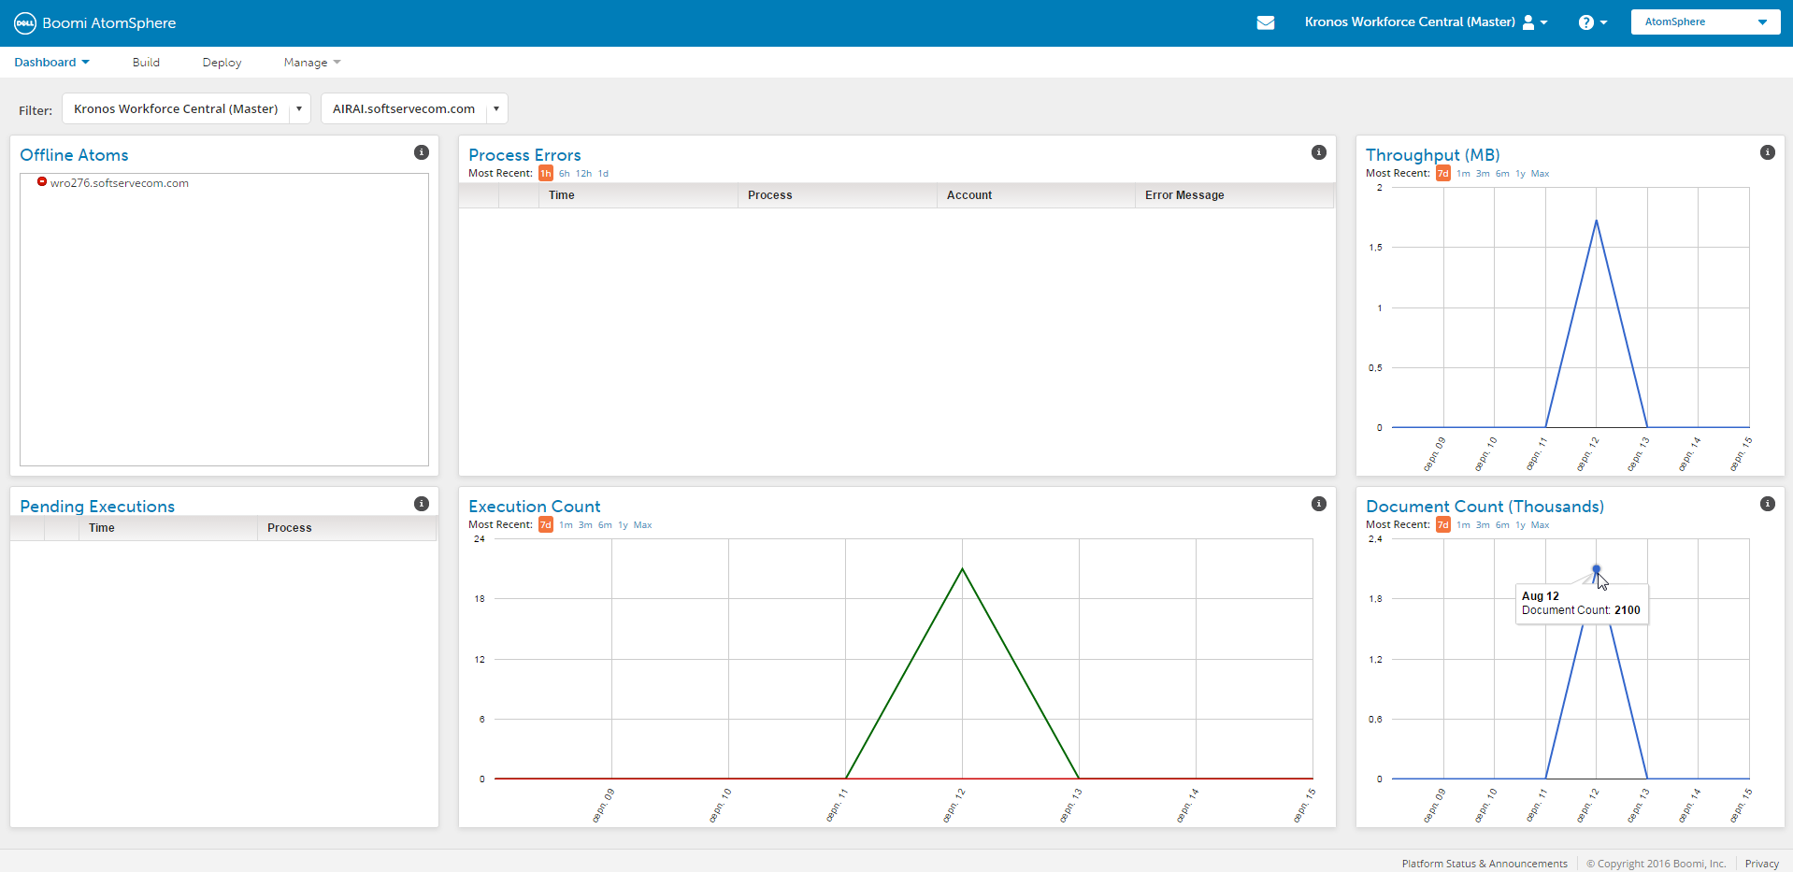
Manual process monitoring
2. Using Dell Boomi Dashboard for Process Monitoring

Slide 5
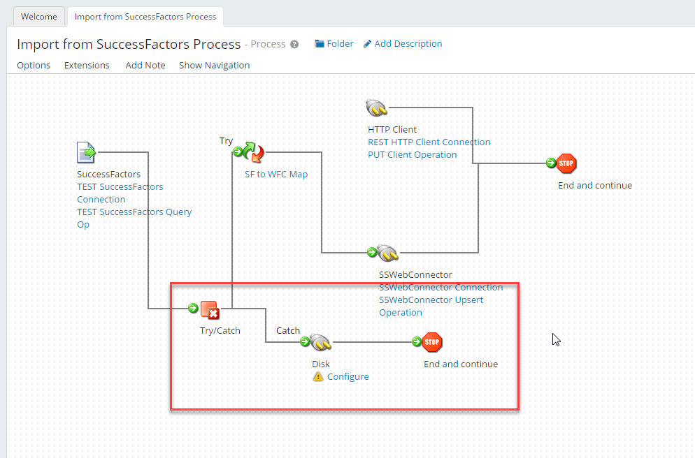
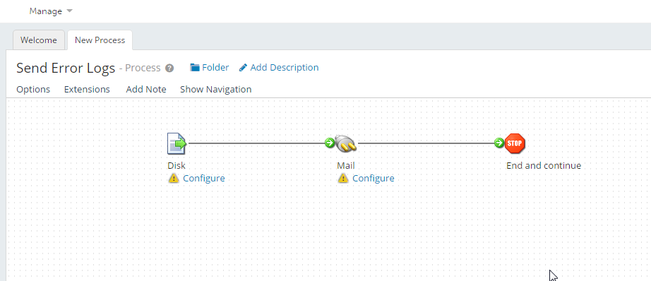
Automated process monitoring
Implement error handling mechanism on Dell Boomi side:
- Store error logs/invalid documents on Disk (file system)
- Create error handling process (for example send error logs/notifications/documents by email)

Slide 6
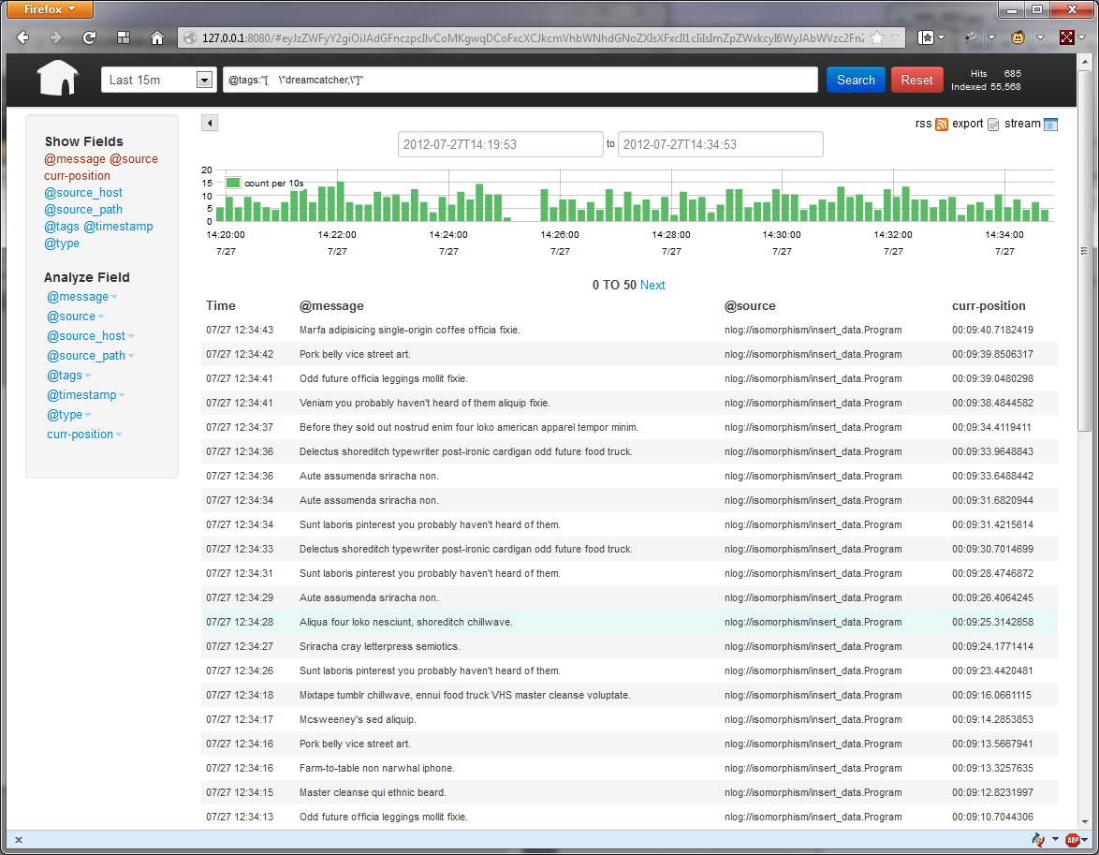
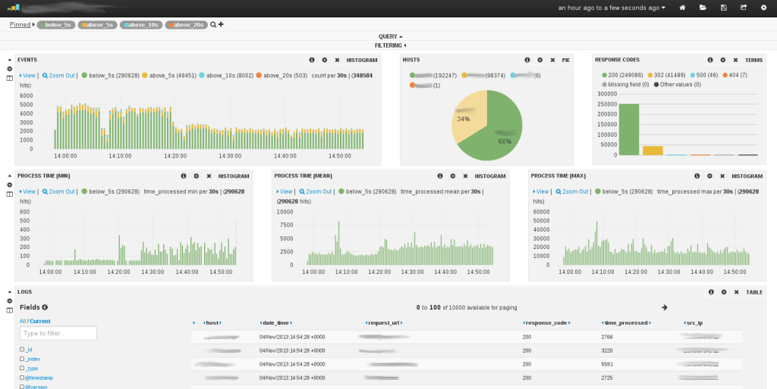
Automated process monitoring
2. Use additional logs analysis tools (for example “Kibana” https://www.elastic.co/products/kibana )

Slide 7
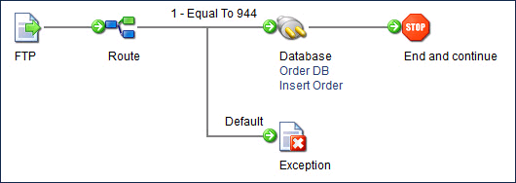
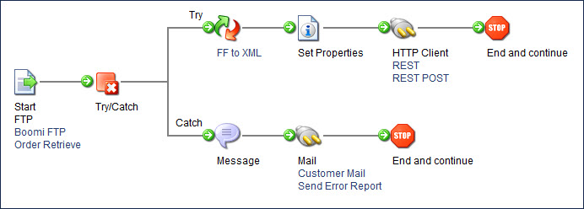
Exceptions handling
Exception shape
Try/Catch shape

Slide 8
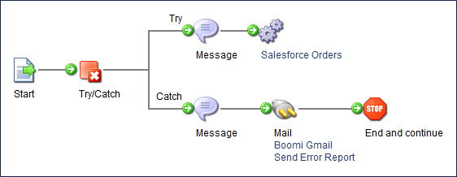
Exceptions handling best practices
Save exceptions to cache for later processing in a subprocess
Auto-generate tickets for failed documents in JIRA or other systems
Processing errors of subprocess
Configuration (Abort if process fails, Wait for process to complete)

Slide 9
Event based processing

Slide 10
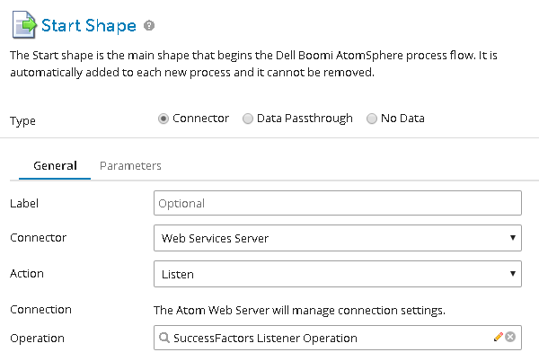
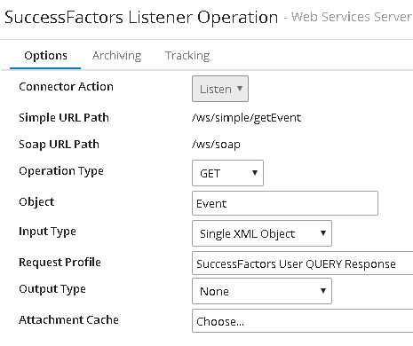
Boomi listeners

Slide 11
Process execution options
Process mode
General
Low Latency
Configuration
Allow Simultaneous Executions
Auto Capture Errors/Warnings To Local Log
Capture Run Dates
Purge Data Immediately
Only Generate Process Log On Error (Low Latency Only)

Slide 12
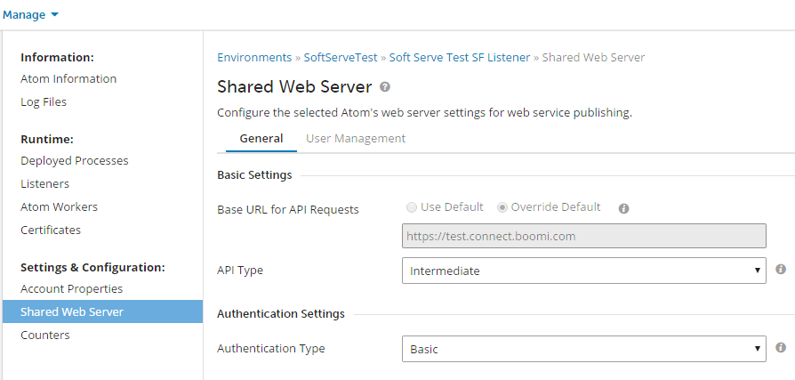
Boomi Shared Web Server

Slide 13
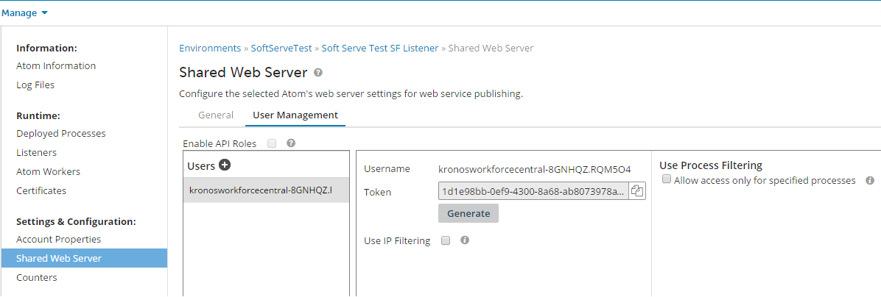
Boomi Shared Web Server User Management

Slide 14
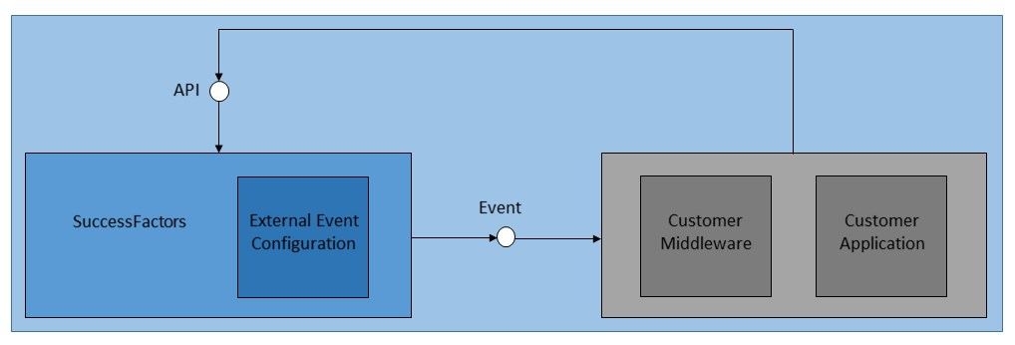
SuccessFactors Event Architecture
Use the Event Center to view and monitor events
Use the Event Notification Subscription tool to configure subscriptions

Slide 15
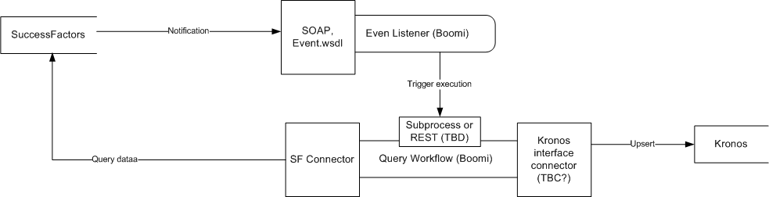
SuccessFactors Boomi NRT integration

Slide 16
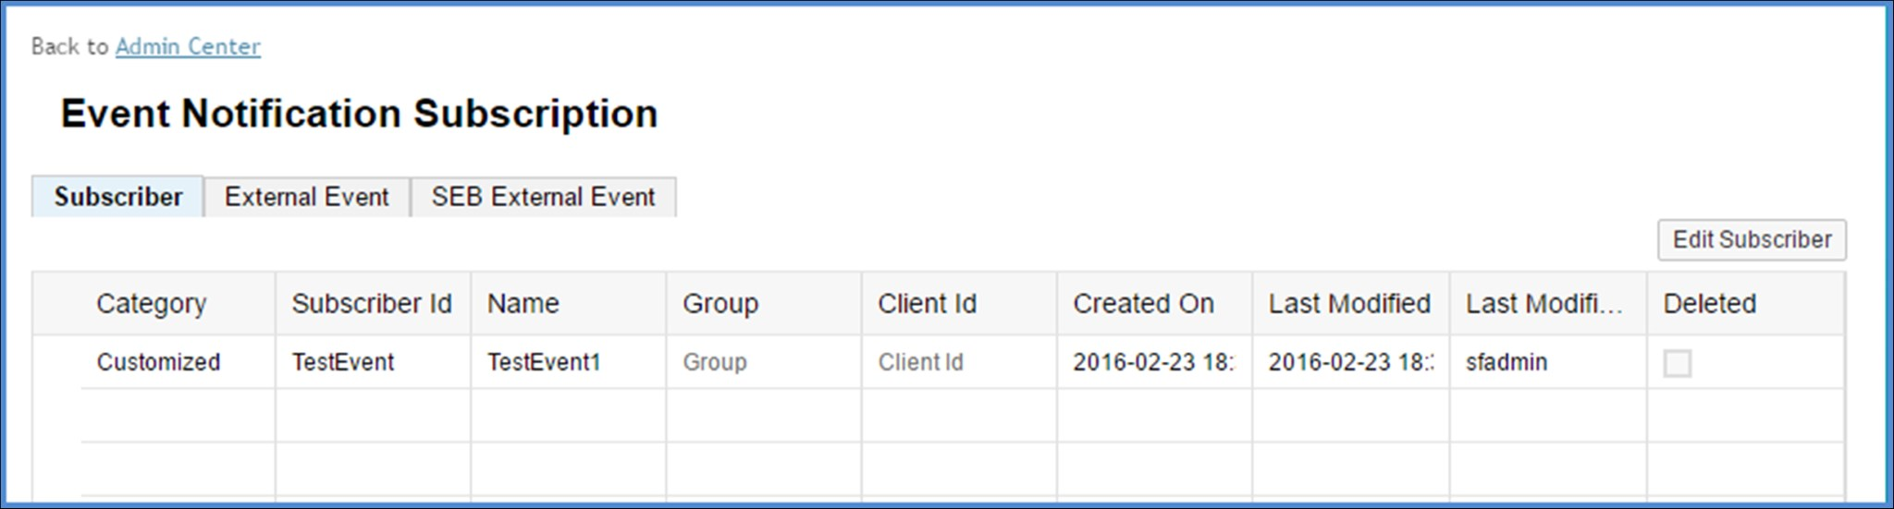
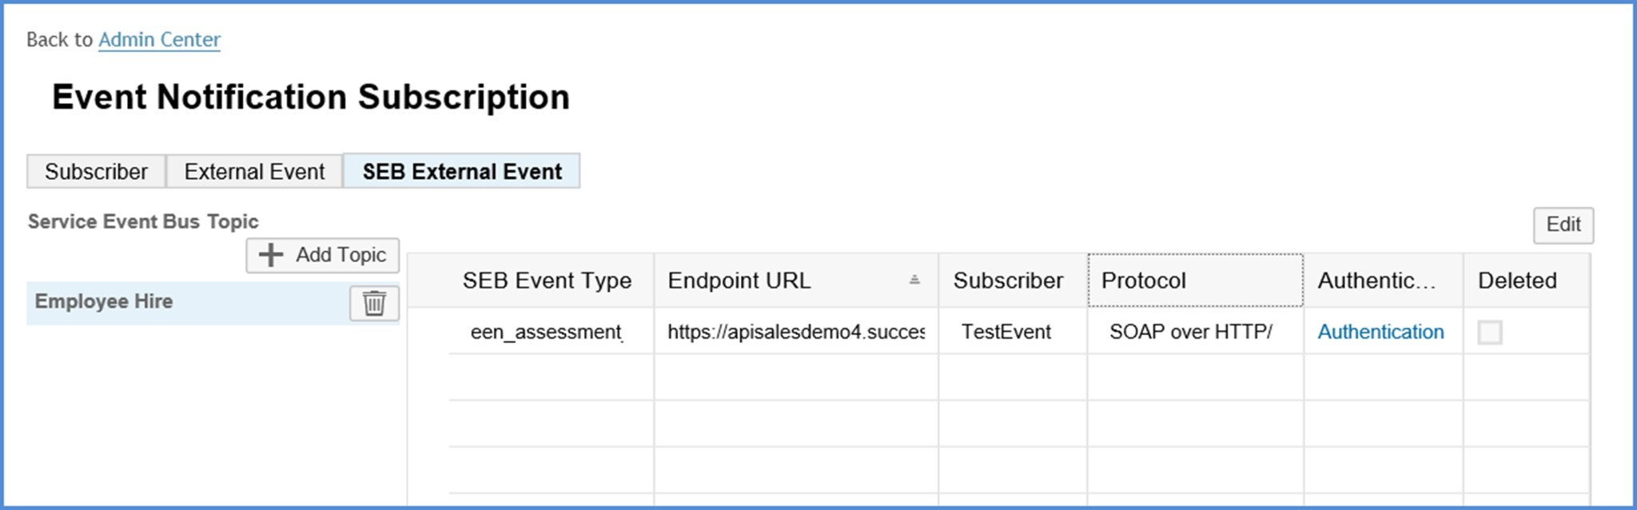
SuccessFactors Subscription example

Slide 17
Thank You

